Slide 1
Amazon Sales Data Analysis
Presented By
Anant Anugrah Tudu

Slide 2

Introduction
In today's digital age, e-commerce giants like Amazon play a pivotal role in global retail. Understanding and optimizing sales data is crucial for staying competitive and driving profitability. This project delves deep into Amazon's sales trends, leveraging advanced data science techniques to uncover key insights that inform strategic decision-making. Join us as we explore the dynamics of Amazon's sales landscape, from monthly fluctuations to overarching yearly trends, and discover the factors influencing these patterns.

Slide 3
Details of Data
Region: The geographical region where the sale occurred (e.g., Australia and Oceania, Central America and the Caribbean).
Country: The specific country within the region where the sale occurred (e.g., Tuvalu, Grenada).
Item Type: The category/type of the item sold (e.g., Baby Food, Cereal, Office Supplies).
Sales Channel: Indicates whether the sale was made online or offline.
Order Priority: Priority of the order (e.g., H for high, L for low).
Order Date: Date when the order was placed.

Slide 4
Order ID: Unique identifier for each order.
Ship Date: Date when the order was shipped.
Units Sold: Number of units of the item sold in that transaction.
Unit Price: Price per unit of the item.
Unit Cost: Cost per unit of the item.
Total Revenue: Total revenue generated from the sale (Units Sold * Unit Price).
Total Cost: Total cost incurred (Units Sold * Unit Cost).
Total Profit: Total profit made from the sale (Total Revenue - Total Cost).

Slide 5
KPI
Sales Trends: Analyze sales patterns month-over-month to identify seasonal trends and fluctuations.
Average Order Value (AOV): Average amount customers spend per order.
Customer Acquisition Cost (CAC): Cost to acquire a new customer.
Customer Lifetime Value (CLV): Predicted revenue a customer will generate over their lifetime.
Customer Segmentation: Analyze sales performance by different customer segments.
Price Sensitivity: Understand how price changes affect sales volume.
Market Basket Analysis: Identify products frequently purchased together.
Customer Behavior: Analyze customer journey data to optimize sales strategies.

Slide 6
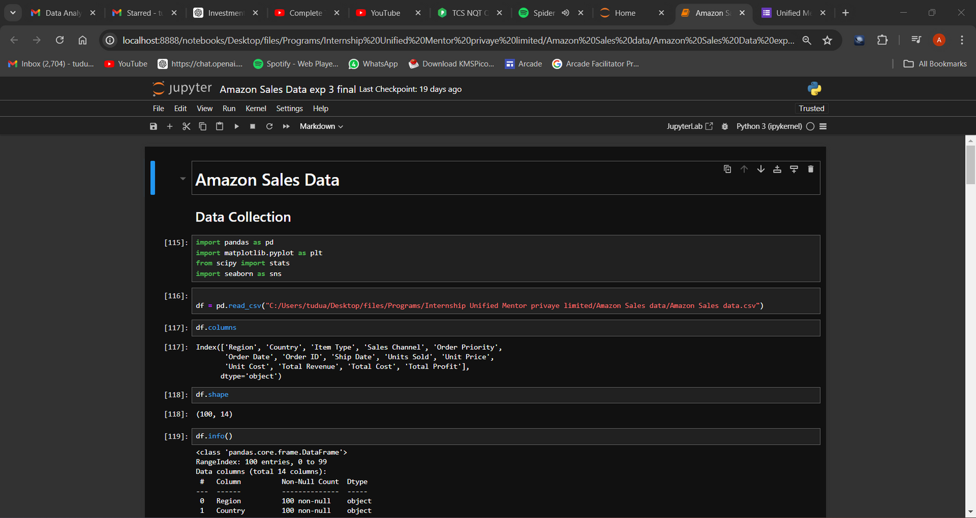
Screenshots

Slide 7
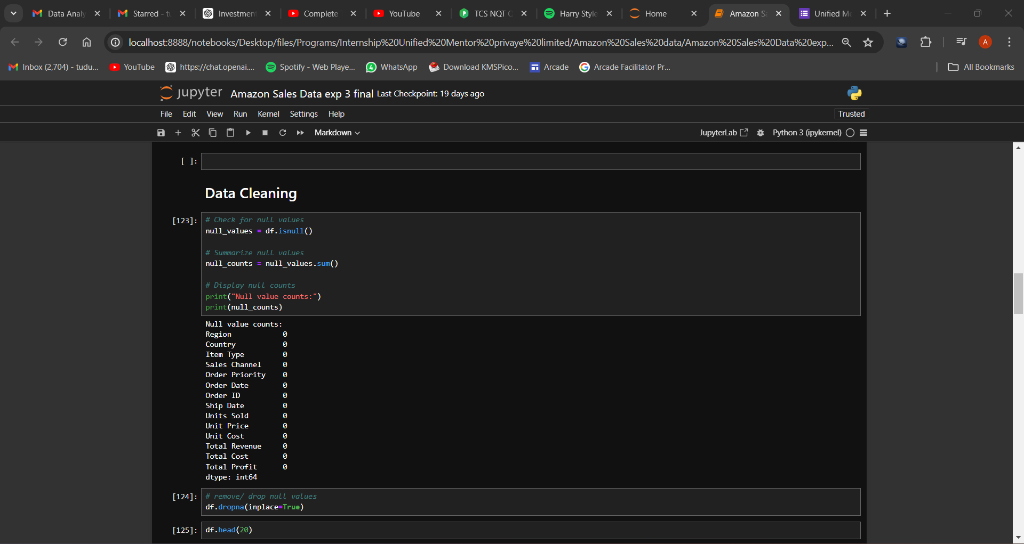

Slide 8
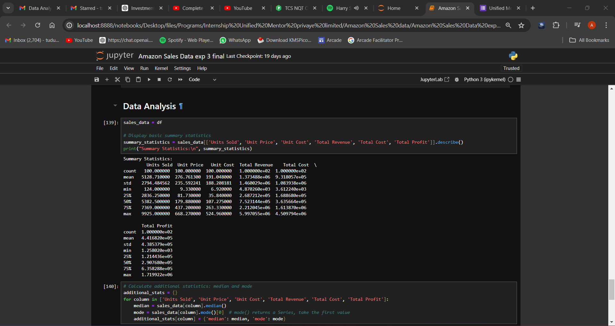

Slide 9
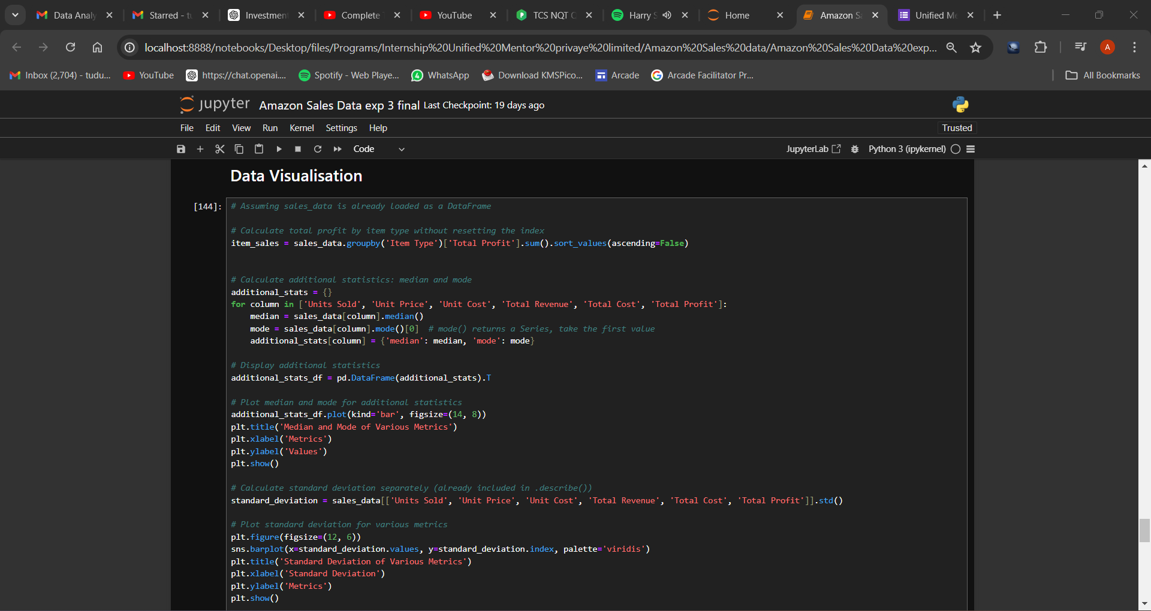

Slide 10
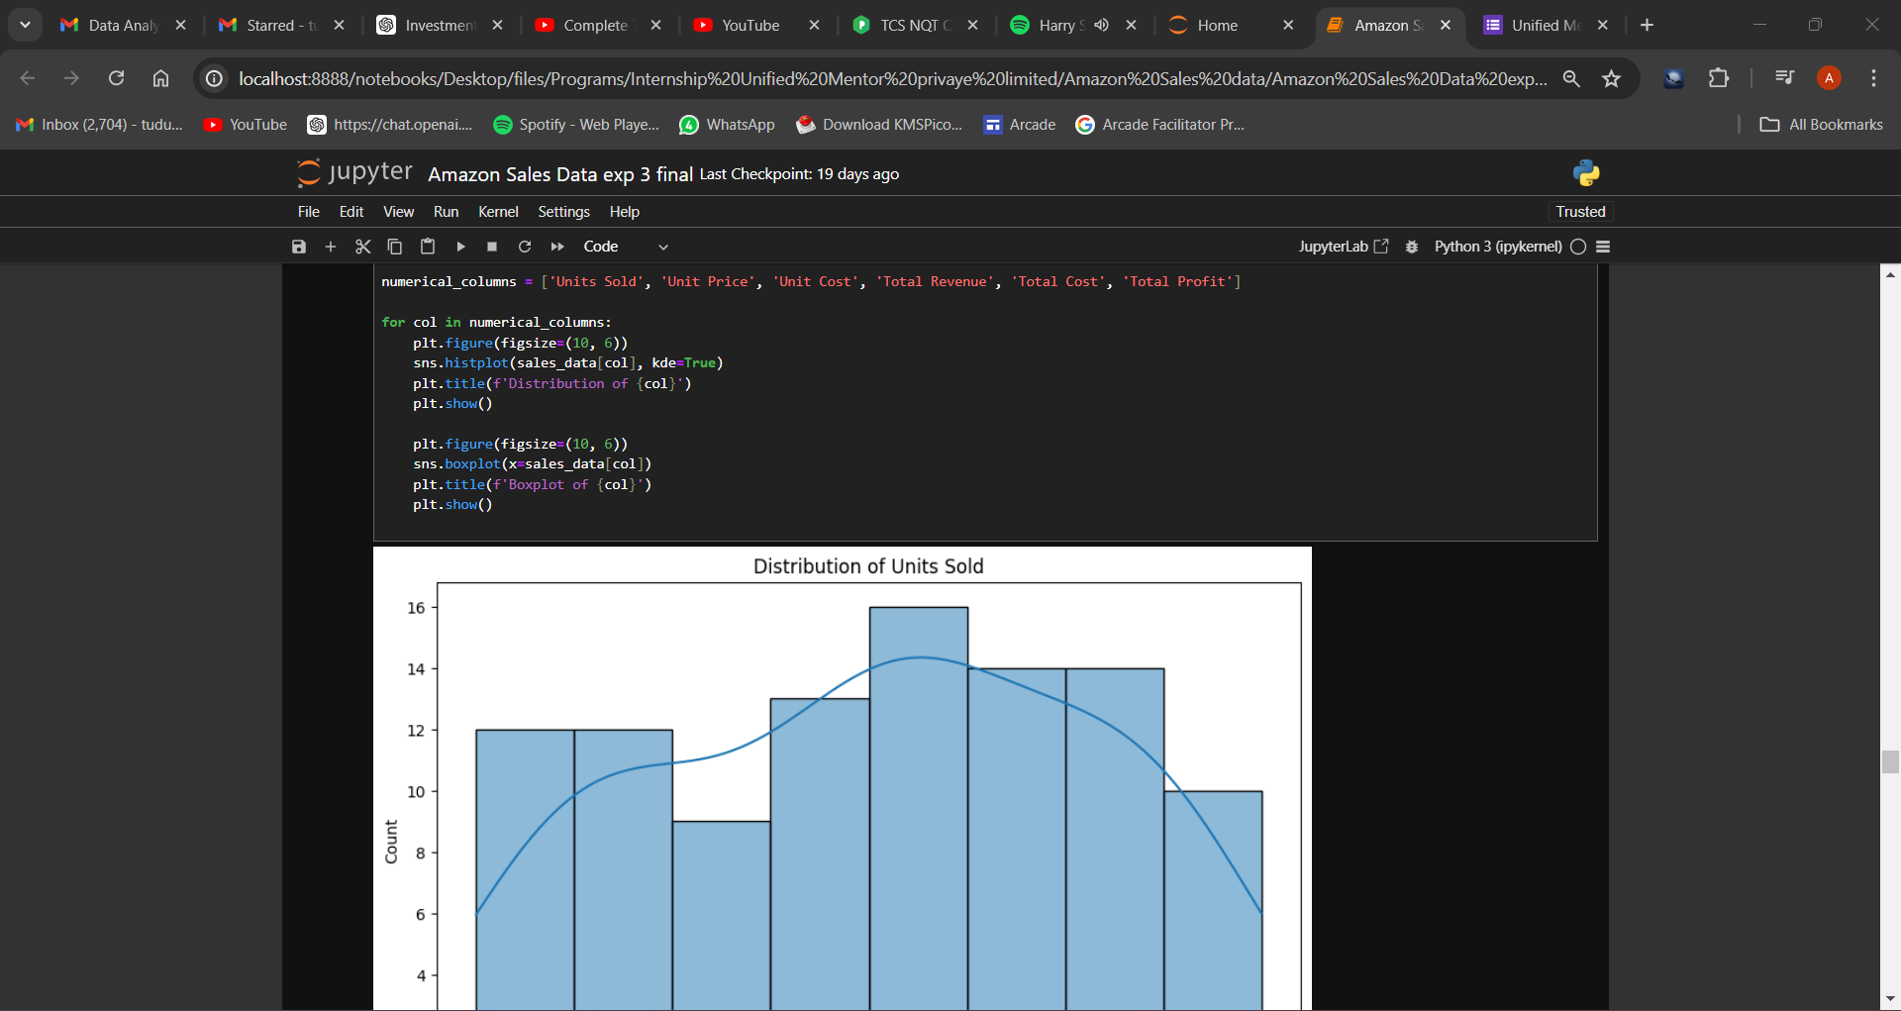

Slide 11
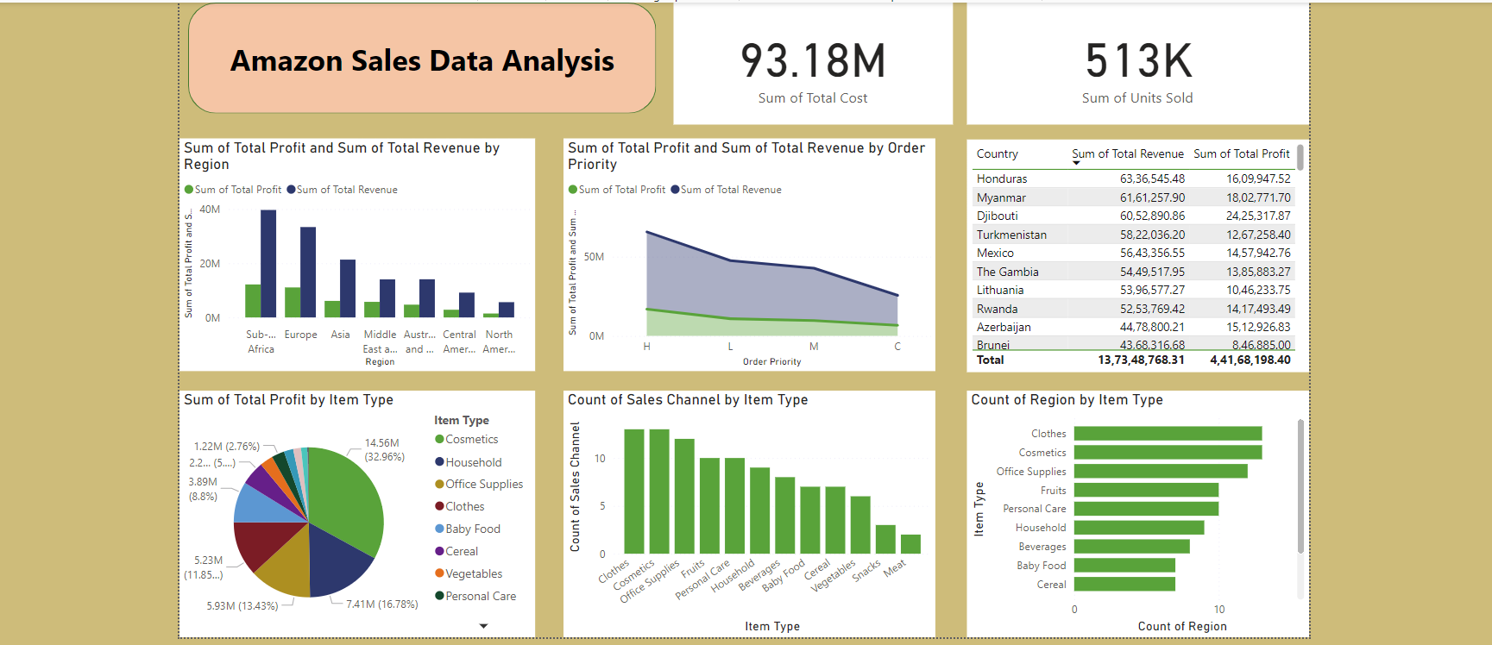
Dashboard

Slide 12
Insights
High revenue is generated by by regions like Sub-Saharan Africa, Europe and Asia.
High revenue is generated by by countries like Honduras, Myanmar and Djibouti.
Most profitable items are Cosmetics, Household Items and Office Supplies.
Offline sales genrates more revenue and more profit compared to online sales.
Order Priority of products are H , L , M , C.
Units Sold is negatively corelated to Unit Price & Unit Cost but positively corelated to Total Revenue & Total Cost.
Units Price is negatively corelated to Unit Sold but positively corelated to Unit Cost, Total Revenue & Total Cost.
Units Cost is negatively corelated to Unit Sold but positively corelated to Units Price, Total Revenue & Total Cost.
Total Revenue is positively corelated to Units Sold , Unit Price , Unit Cost & Total Cost.
Total Cost is positively corelated to Units Sold , Unit Price ,Unit Cost & Total Revenue.

Slide 13
Thank you!

